Slide 1
Build x : android
Lecture Three: Recap and ListViews

Slide 2
Recap

Slide 3
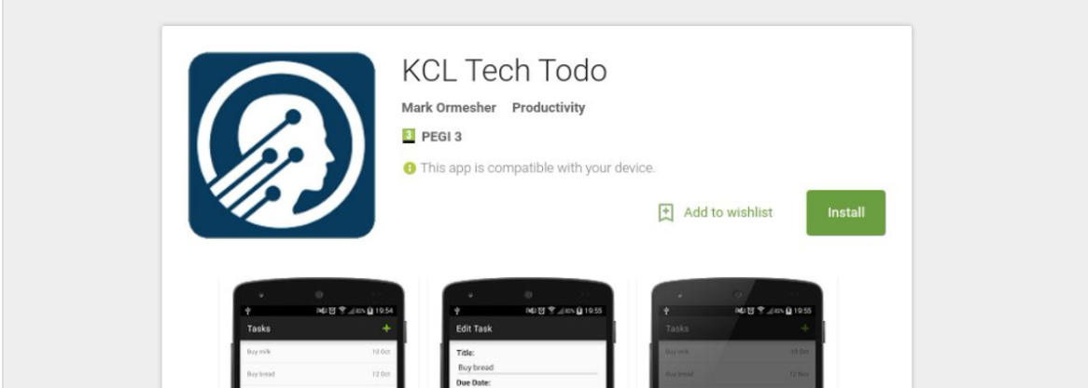
Recap – What are we doing?
We’re going to build a basic todo list app, KCL Tech Todo.
If you want a preview, it is available on Google Play.
Search for ”KCL Tech Todo” on Google or on the Play Store.

Slide 4
Recap – Layouts, Views and View Groups
Layout: a specific type of application resource
These define the structure and appearance of parts of your app
View: an individual component of a layout
A button, input field, text field, image, etc.
View Group: a special type of View that can contain other views
You can’t see the view group, but you can see the views inside of it
LinearLayout, ScrollView, RelativeLayout, etc.
Other Resources: used to supplement a layout, amongst other things
Strings, styles, dimensions, etc.

Slide 5
Recap – Events, Intents and the Activity Lifecycle
Events: your app can “listen” to all types of events on all types of views
Once you have a reference to your view in Java, it’s easy to set an action listener with a few lines of code.
Intents: these tell Android that your app intends to do something
Usually these start a new activity, but they can do all sorts of other things.
Activity Lifecycle: your activity will move through many different states
A callback method is called when each of your activities moves to a new state, such as onPause().

Slide 6
How would you display a list of items?
How would you scroll through them?
What happens if the data changes?
What happens when items are not on the screen?
Where would you get the data from?

Slide 7
ListViews

Slide 8
ListViews
A ListView displays a list of items.
They are the most common type of complex view.

Slide 9
ListViews – What’s the point?
When it comes to memory, views are expensive, and making them is even more expensive!
A View usually consumes a couple of KB of RAM, and with complicated layouts this can really add up.
Imagine having 100 contacts in the phone book, each having a name, number, picture and probably more views/view groups - that’s already a few MB of memory before any computation.

Slide 10
List Views – What’s the point?
A ListView will recycle views when they aren’t needed, which is much more efficient.

Slide 11
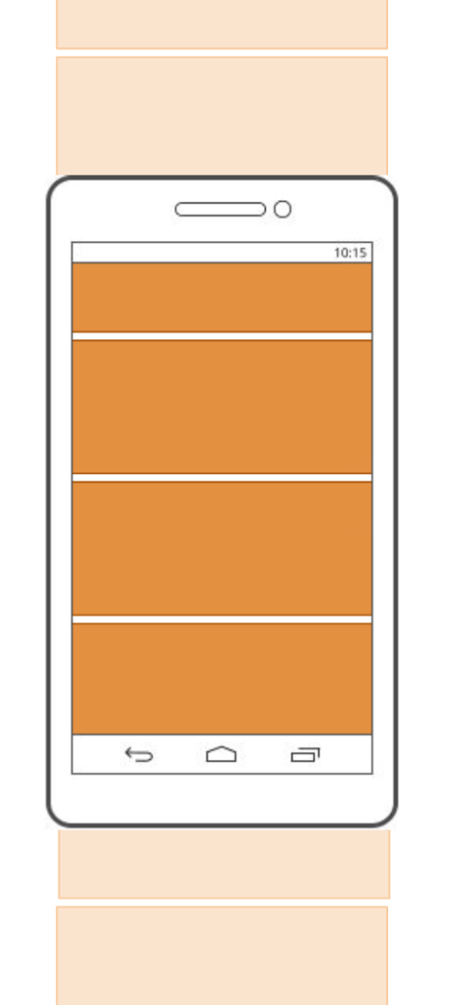
ListViews - Recycling
The Wrong Way:
Don’t recycle them at all. Create a new view
for each item, taking up a ton of memory
and slowing things down.

Slide 12
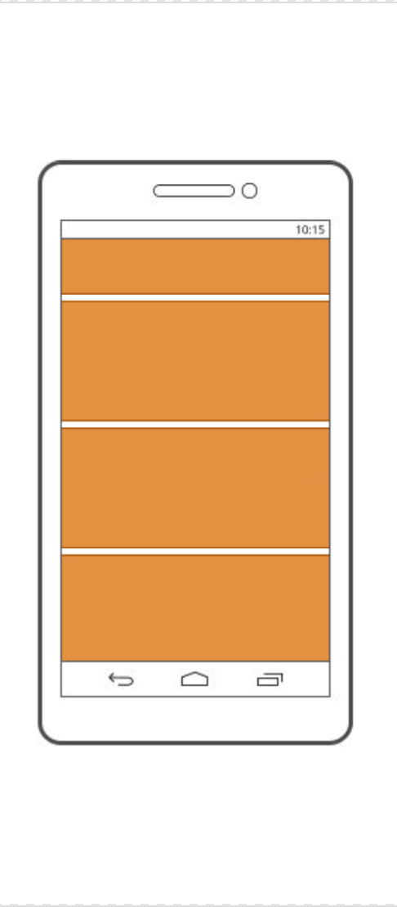
ListViews - Recycling
The Right Way:
When the user scrolls down, a view
”disappears” off the top.

Slide 13
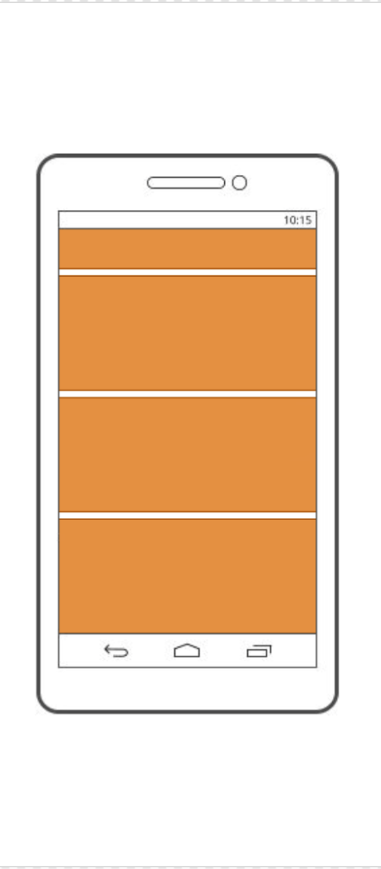
ListViews - Recycling
The Right Way:
When the user scrolls down, a view
”disappears” off the top.

Slide 14
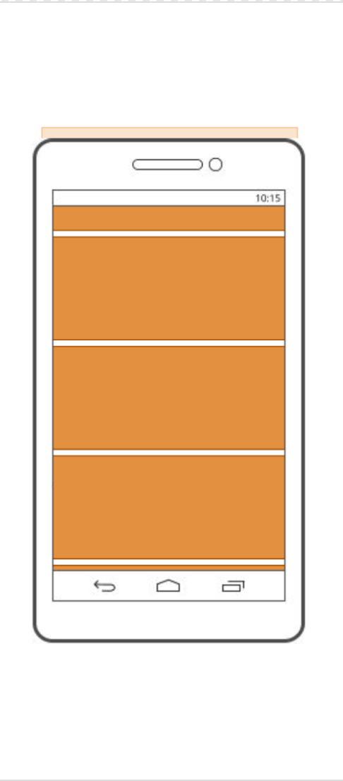
ListViews - Recycling
The Right Way:
When the user scrolls down, a view
”disappears” off the top.

Slide 15
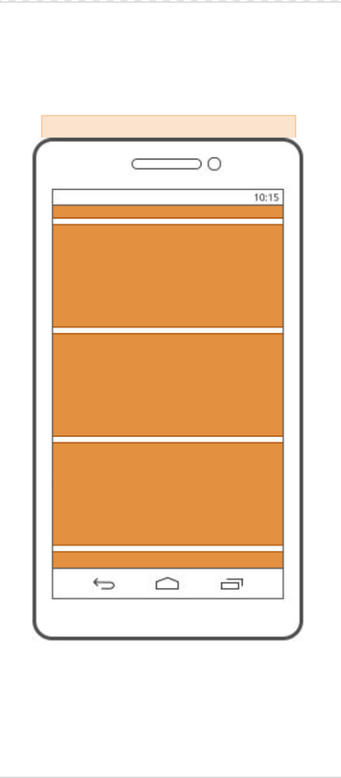
ListViews - Recycling
The Right Way:
When the user scrolls down, a view
”disappears” off the top.

Slide 16
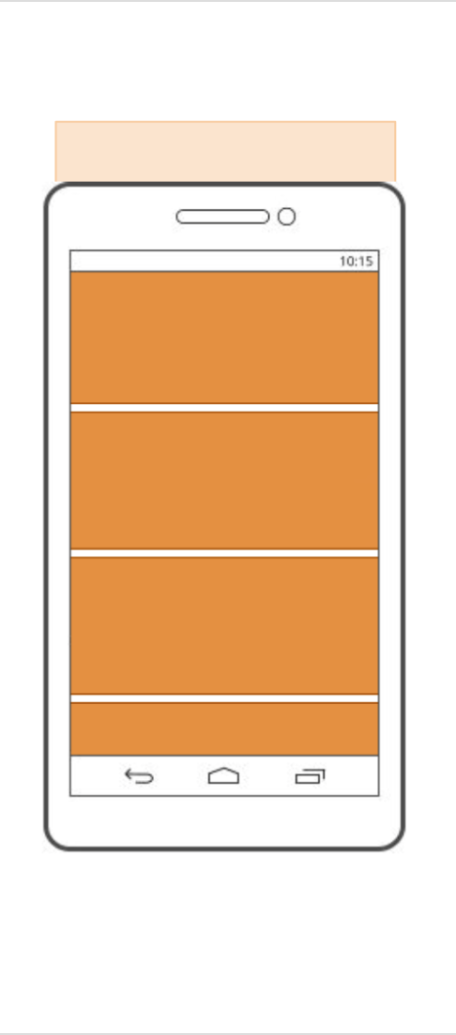
ListViews - Recycling
The Right Way:
When the user scrolls down, a view
”disappears” off the top.

Slide 17
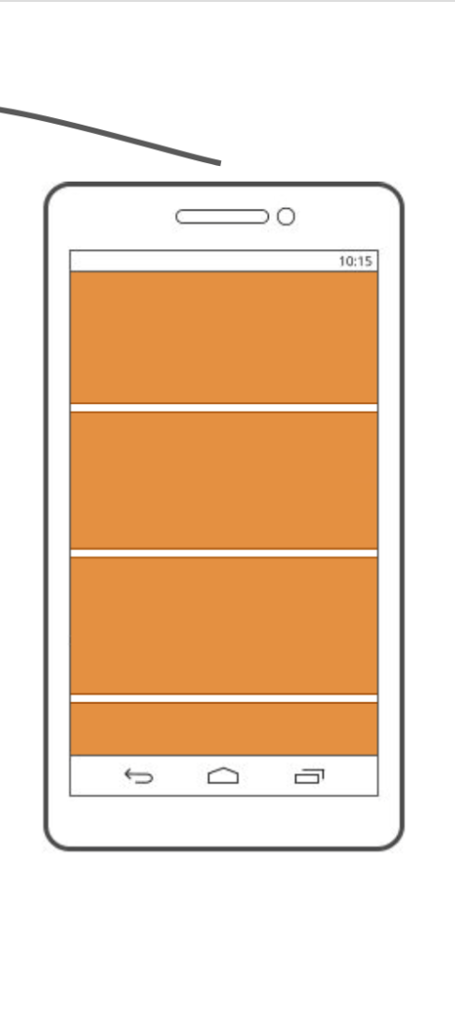
ListViews - Recycling
The Right Way:
The view is then taken away…

Slide 18
ListViews - Recycling
The Right Way:
The view is then taken away…
…recycled…

Slide 19
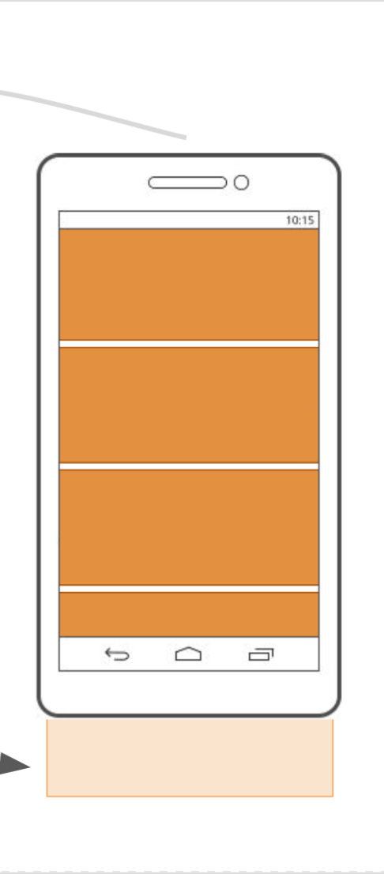
ListViews - Recycling
The Right Way:
The view is then taken away…
…recycled…
…and replaced back at
the bottom, ready to
appear.

Slide 20

ListViews – Joining the Dots
Magic?

Slide 21
ListViews – Joining the Dots
Nope.

Slide 22
ListViews – Joining the Dots
An
Adapter

Slide 23
ListView Adapters
An adapter maps your ListView to a data source – a list of contacts, the tasks in our todo app, etc.
An adapter is just a Java class that as certain methods, used by a ListView.
Adapters help maintain the separation of concerns in your software.
Your data does not know, and does
not care, that it is being displayed in a
ListView.
The ListView does not know, and does
not care, what your data represents.

Slide 24
ListView Adapters
The process is simple: you give your data to the adapter, and the ListView uses the adapter to retrieve your data (and information about it).
This allows you to build a custom adapter to accept any kind of data you have, and expose a standard pre-defined interface that a ListView can understand.

Slide 25
ListView Adapters
An
Adapter

Slide 26

ListView Adapters
An
Adapter

Slide 27

ListView Adapters
An
Adapter

Slide 28

Break! (10 mins)

Slide 29
ListViews
A ListView displays a list of items.
They are the most common type of complex view.

Slide 30
ListView Adapters
An
Adapter

Slide 31

Coding time!

Slide 32
Next Week: Databases
Next week we’re going to be studying the use of databases in Android apps.
We’re not doing anything exotic with them, but if you haven’t used databases in a while, do a little reading to brush up on them.
If you know roughly what these words and terms mean, you’re all good.
database table column
record row query SQL

Slide 33

Break! (10 mins)

